Slide 1
Class 7

Slide 2
Learning Objectives
What is baseline ServiceNow implementation?
What distinguishes plugins from applications?
What is difference between configurations (change you want to make with ServiceNow giving you this ability out of the box) and customizations (change or enhancement that you need to do yourself)?

Slide 3
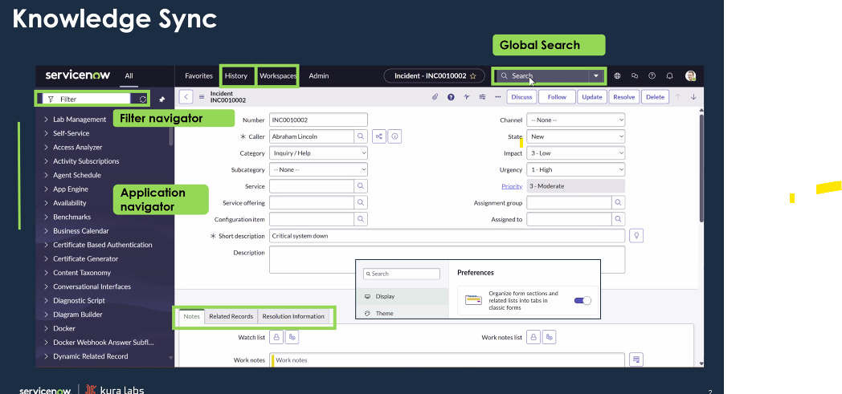

Slide 4
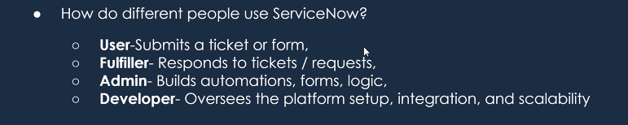
Review
Application Platform as a Service (aPaaS) – not worrying about application code, drag and drop low code in order to customize ServiceNow App. ServiceNow makes it easy to create your own platform for your own needs.
They can build applications with centralized control over updates, roles, and data integrity without managing infrastructure.
Focus on designing the logic
How do different people use ServiceNow?
Developer, IT, agents, HR, contact center, end users, sys admins
Different roles need different UIs

Slide 5
Baseline Implementation
Baseline applications that are included
Set of installed apps on a ServiceNow instance before any configuration or customization has been done.
What is an instance?
An instance is a copy of a ServiceNow environment that is specific to a customer.
There are Prod and Non-prod environments:
Production
Non-production
Development – where apps are built by admins
Test – where implementers test their changes before moving to prod
PDI (personal developer instance) – independent instance where developer and others may install, configure, develop, and learn

Slide 6
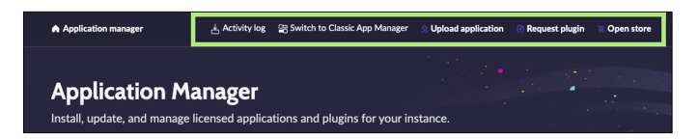
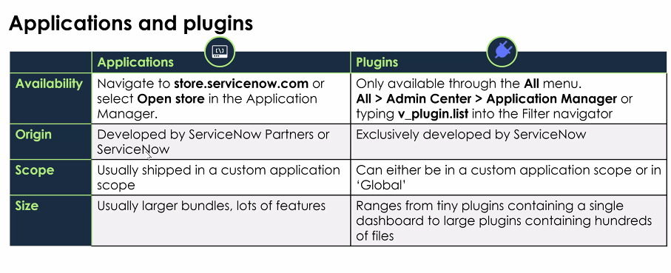
Applications and plugins
Set of modules, tables, forms, workflows. Designed to solve a specific problem.
Add on to an application
Big plugin: Discovery plugin – allows ServiceNow to go to all apps, scan them and load to database.

Slide 7
Configuration and customization
Configuration – something already exists and you make some changes to it. Set up certain things that are already there.
Most of admins do
Things done without code
Customization – make something detailed. Modifying the ServiceNow to suit the needs of the org.

Slide 8
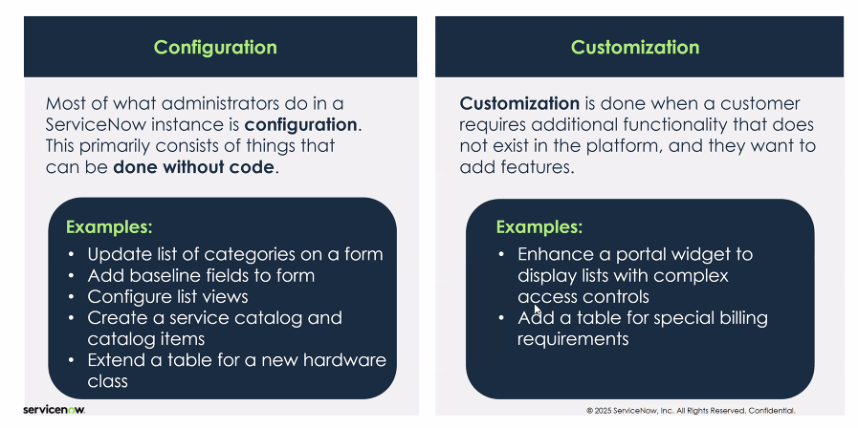

Slide 9
Configuration – changing already existing
Customization – creating something new
Configuration - Adding a new field – because it already exists.
Customization - In JavaScript a specific flow creating from scratch, anything that you are building out.

Slide 10
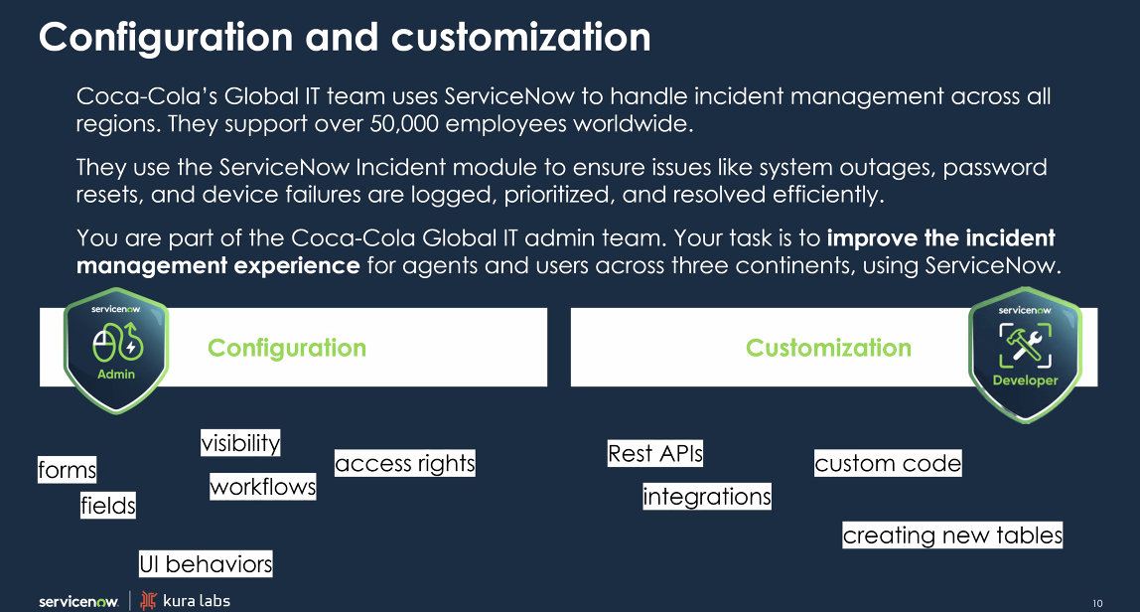

Slide 11
Walkthrough
Add a Custom Field to the Incident Form

Slide 12
Section has an owner – global
Ability to change the field options – incident manager

Slide 13
Objectives Retrospection
What is baseline ServiceNow implementation?
Serves as a foundation for platform development
What distinguishes plugins from apps and plugins?
Standalone apps vs apps additions
Configuration – ability to create things that are in ServiceNow already, customization – new, not from ServiceNow

